Slide 1


The Analytics Team
Sprocket Central Pty Ltd
Data Analytics Approach
KRISH BATRA

Slide 2
AGENDA
Introduction
Data Exploration
Model Development
Interpretation

Slide 3
INTRODUCTION
Identify and Recommend Top 100 Customers to Target from Datasets
OUTILNE OF PROBLEM
Sprocket Central is a company that specializes in high-quality bikes and cycling accessories.
Their Marketing Team is looking to boost business sales by provided datasets.
Using the 3 datasets provided the aim is to analyse and recommend 1000 customers that Sprocket Central should target to drive higher value for company.
Contents of Data Analysis
‘New’ and ‘Old’ Customer Age Distributions.
Bike related purchases over the last 3 years by gender
Job Industry Distributions
Wealth segmentation by age category
Number of cars owned or not owned by state.
RFM Analysis and Customer Classification.

Slide 4
DATA EXPLORATION

Slide 5
Data Quality Assessment and ‘CLEAN UP’
Key Issues for Data Quality Assessment
Accuracy: Correct Values
Completeness: Data fields with Values.
Consistency: Values Free from Contradiction.
Relevancy: Data items with Value Meta-Data
Validity: Data Containing Allowable Values
 | Accuracy | Completeness | Consistency | Currency | Relevancy | Validity
Customer Demographic | DOB: Inaccurate Age: Missing | Job Title: Blanks Customer_ID: Incomplete | Gender: Inconsistency | Deceased Customers: Filter Out | Default column: DELETE
Customer Address |  | Customer_id Incomplete | States: Inconsistency
Transactions | Profit: Missing | Customer_id: Incomplete Online order: Blanks Brand: blanks |  |  | Cancelled status order: filter out | List Price: Format Product Sold Date: Format

Slide 6
‘New’ And ‘Old’ Customer Age Distribution
Most customers are aged between 40-49 in ‘New’. In ‘Old’ majority of customers are aged between 40-49 also.
The Lowest Age groups are under 20 and 80+ for both ‘New’ And ‘Old’ Customer lists.
The ‘New’ Customer list suggests that age groups 20-29 And 40-69 are the most populated.
The ‘Old’ customer lists suggest 20-69.
There is a steep drop in customers in the 30-39 Age group in ‘New’.

Slide 7
Bike related purchases over last 3 years by gender
Over the last three years about 50 % of bike related purchases were made by females to 48% of purchases made by males. Approximately 2% were made by unknown gender.
Numerically, females purchases almost 10,000 more than males.
Females make up the majority of bike related sales

Slide 8
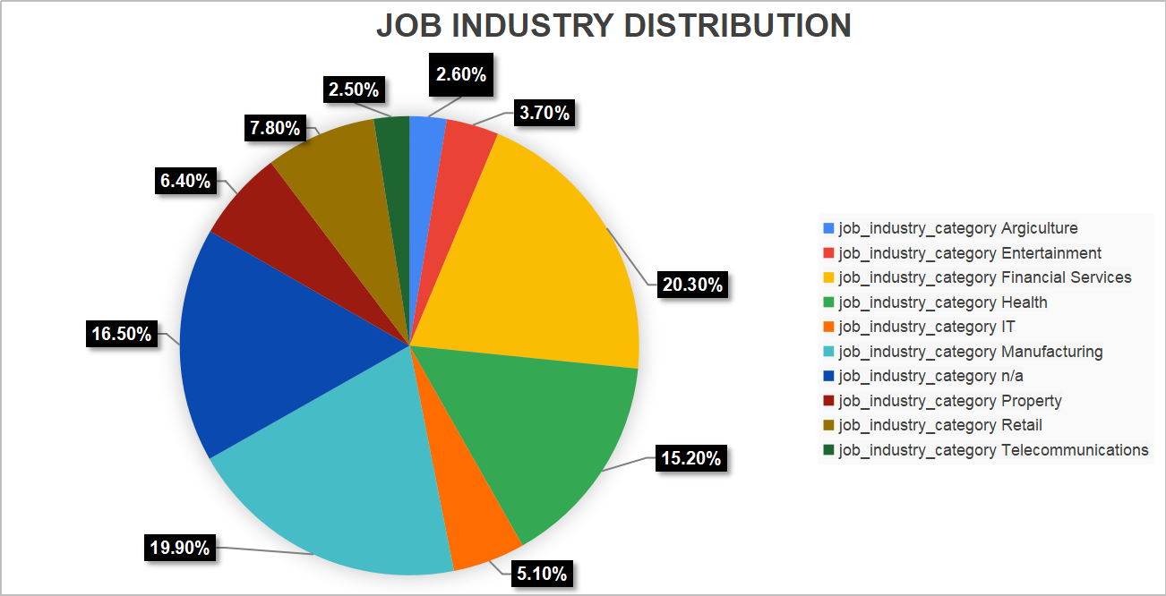
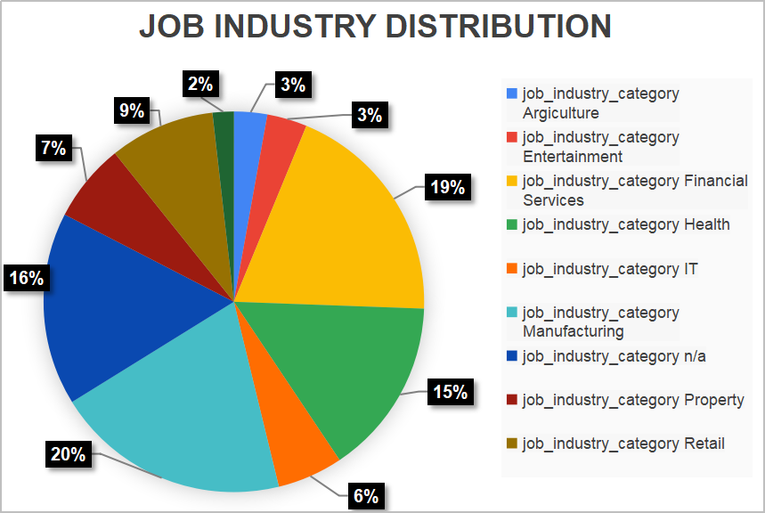
Job Industry Distribution
20% of ‘New’ Customers are in Manufacturing and Financial Services.
The smallest number of customers are in Agriculture and Telecommunications at 3%
Similar pattern in ‘Old’ customer list, at 20% and 19% in Manufacturing and Financial Services respectively.

Slide 9
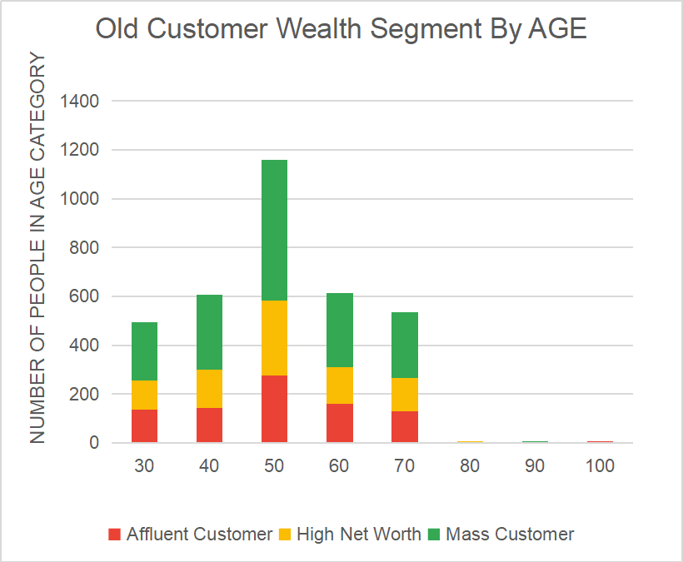
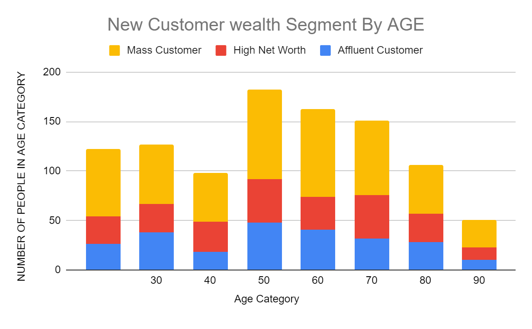
Wealth Segmentation by Age Category
In all age categories the largest number of customers are classified as ‘Mass Customers’.
The next category is the ‘high Net Worth’ customers.
The ‘ Affluent Customer’ can outperform the ‘High Net Worth’ customer in the 40-49 age group.

Slide 10
Number of cars owned and not owned by state
NSW has the largest amount of people that do not own a car, NSW seems to have a higher number of people form which data was collected.
Victoria is also split quite evenly. But both numbers are significantly lower than those of NSW.
QLD has a relatively high number of customers that own a car.

Slide 11
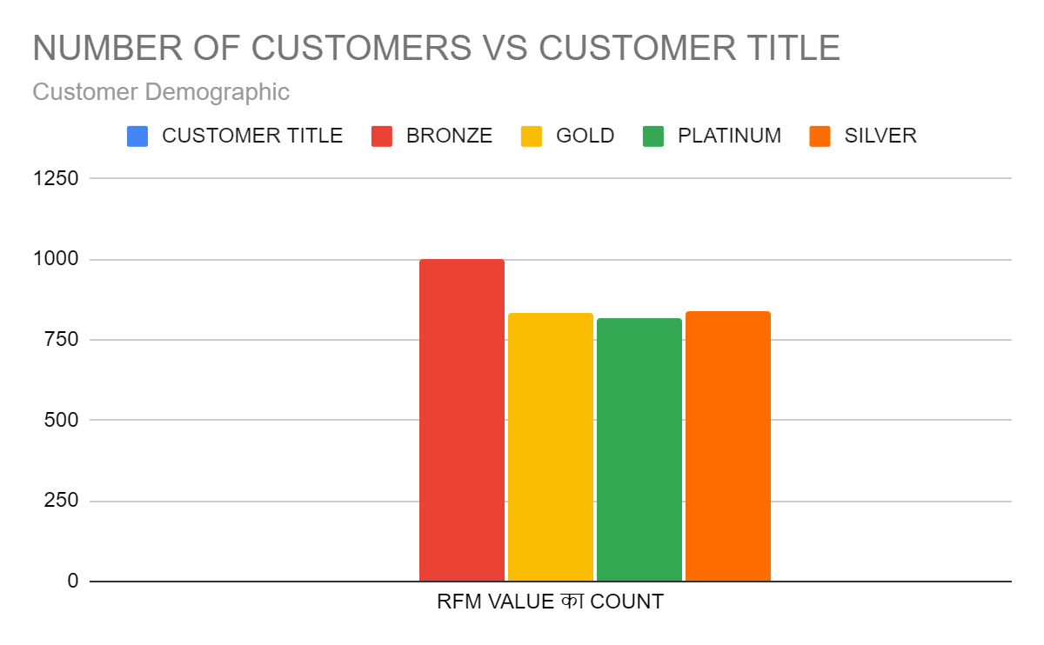
RFM Analysis and Customer Classification
RFM Analysis is used to determine which customers a business should target to increase its revenue and value.
The RFM(Recency, Frequency, and Monetary) model shows customers that have displayed high levels of engagement with the business in three categories mentioned.

Slide 12
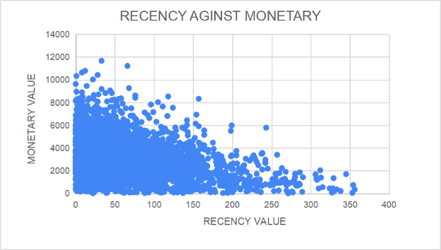
Scatter-Plot based off RFM Analysis
The chart shows that customers who purchased more recently have generated more revenue than customer who visited a while ago.
Customers from recent past (50-100 days) also show to generate a moderate amount of revenue.
Those who visited more than 200 days ago generate low revenue.

Slide 13
Scatter-Plot based off RFM Analysis
Customer classified as “Platinum Customer”, ”Very Loyal”, and “Becoming Loyal” visit frequently, which correlated with increased revenue for the business.
Naturally, there is a positive relationship between frequency and monetary gain for the business.

Slide 14
Scatter-Plot based off RFM Analysis
Very Low frequency of 0-2 correlated with high recency values. i.e. More than 250 days ago.
Customers that have visited more recently(0-50 days) have a higher chance of visiting more frequently(6+).
Higher frequency has a negative relationship with recency values. Such that very recent customers are also frequent customers.

Slide 15
Customer Title Definition list with RFM Values assigned
RANK | Customer Title | Description | RFM Value
1 | Platinum Customer | Most recent buy, buys often, most spent | 444
2 | Very Loyal | Most recent , buys often, spends large amount of money | 443
3 | Becoming loyal | Relative recent, bought more than once , spends large amount of money | 421
4 | Recent Customer | Bought recently, not very often, average money spent | 344
5 | Potential customer | Bought recently, never bought before, spent small amount | 323
6 | Late Bloomer | No purchases recently, but RFM value is larger than average | 311
7 | Losing Customer | No purchases recently, but RFM Value is larger than average. | 224
8 | High Risk Customer | Purchase was long time ago, frequency is quite high, amount spent is high | 212
9 | Almost Lost Customer | Very low recency, Very low frequency but high amount spent | 184
10 | Evasive Customer | Vey low recency, Very low frequency and low amount spent | 176
11 | Lost Customer | Very Low RFM | 111

Slide 16
Customer Target and Methodology
RANK | Customer Title | Description | Number of Customers | Cumulative | Customer Section
1 | Platinum Customer | Most recent buy, buys often, most spent | 176 | 176 | 176
2 | Very Loyal | Most recent, buys often , spends large amount of money | 184 | 360 | 184
3 | Becoming Loyal | Relatively recent, bought more than once, spends large amount of money | 344 | 708 | 344
4 | Recent Customer | Bought recently, not very often, average money spent | 368 | 1072 | 296
Filter through the top 1000 customers by assigning the conditions discussed in the table above.
The 1000 customers discovered would have bought recently, they have bought very frequently in the past and tend to spend more than other customers.

